Slide 1
THE NATIONAL COMPETITIVENESS COUNCIL OF GUYANA

Slide 2
THE STRUCTURE OF THE NATIONAL COMPETITIVENESS COUNCIL
The National Competitiveness Council is Guyana’s highest public-private Advisory Council. It formalizes the public-private partnership for Competitiveness. The National Competitiveness Council has twelve members.
Six of these members are of the Government:
The President who chairs the Council (or in his absence, the Prime Minister)
The Minister representing Public Works, Energy, and Telecoms, or the Minister of Finance
The Minister of Tourism, Industry and Commerce
The Minister of Foreign Trade and International Cooperation
The Minister of Agriculture
The Chief Executive Officer of GoInvest

Slide 3
Structure.
Four are of the Private Sector:
A Representatives selected by the Private Sector Commission
A Representative selected by the PSC Trade and Investment Sub-Committee
A Representative of the Association of Regional Chambers of Commerce
A Representative of the Small Business Association to the Small Business Council
Two nominees of Organized Labour.

Slide 4
THE MANDATE OF THE NATIONAL COMPETITIVENESS COUNCIL
The Mission of the National Competitiveness Council is to take ownership of the National Competitiveness Strategy and to act as a central point of policy leadership to ensure ongoing strategy development and implementation.
The objectives of the Council are:
To act as a central point of public-private leadership for the National Competitiveness Strategy to oversee and co-ordinate ongoing strategy formulation, ensure that the goals of strategy are adhered to, that policies and programs are implemented, results are monitored, policies and programmes are altered in light of performance, and that new policies and programmes are devised.
To promote and communicate the strategy locally and internationally.
To search for solutions for key cross-cutting issues and challenges facing the country’s economic development.
To search for synergies among donors to improve effectiveness of donor and lender institutions.
The National Competitiveness Council meets quarterly and submits quarterly recommendations to the Sub-Committee of Cabinet for Trade and Investment. The Sub-Committee then proceeds via the normal Government channels.
The Secretariat of the National Competitiveness Council is the Competitiveness Secretariat of the Ministry of Tourism, Industry and Commerce.

Slide 5
The National Competitiveness Council is fed off of three tiers of institutions:
The 1st tier is a decision making tier. It the highest level advisory and decision making bodies for competitiveness strategies, policies and actions and includes Cabinet and the National Assembly.
The 2nd tier is comprised of policy formulation bodies. These bodies make crucial policy recommendations to the decision making bodies.
The 3rd tier is that of policy analysis. The bodies in the third tier provide the critical analytical capabilities required to formulate well-defined and consistent sets of policy recommendations to enhance national competitiveness.

Slide 6
Institutional Structure for Enhancing Guyana’s Competitiveness
1st Tier Strategic Policy Decisions
Economic Services Committee of Parliament
National Assembly
Private Sector Competitiveness Committee
Expanded PSC Trade and Investment Sub-Committee
National Competitiveness Council
Sub-Committee of Cabinet for Trade and Investment
Cabinet
Donor Harmonization Group
External Advice and Harmonization of Dev. Assistance
2nd Tier Policy Formulation
Public Private Partnerships
Small Business Council
Competitiveness Steering Committee
NACEN
Export & Investment Promotion Council
Infrastructure PPD
Private Sector
PSC & Others Strengthened
Small Business
MINTIC
Small Business Unit
Strengthened
Competitiveness
MINTIC
Strengthened
Trade
MOFTIC Strengthened
Investment &
Exports
Goinvest Strengthened
Infrastructure
Works Services Group
MINPW
3rd Tier Analytical/Technical Teams

Slide 7
Most of the bodies incorporated in the above three tiered structure already existed in some form when the system was conceived.
The emphasis was therefore on strengthening existing institutions at all levels, focusing immediately on strengthening the analytical capabilities of the Ministry of Tourism, Industry and Commerce, the Ministry of Foreign Trade and International Cooperation, Goinvest (an investment promoting and facilitating body) and the various key private sector organisations which undergird the decision making bodies.
The National Competitiveness Council was the only completely new major institution which was proposed and established.

Slide 8
ACTION PLAN OF THE NATIONAL COMPETITIVENESS STRATEGY
The Action Plan of the National Competitiveness Strategy contains a total of 122 identified actions/recommendations.
These actions were formulated after contemplation of the existing challenges facing Guyana and a summary matrix was prepared showing the action/policy recommendation, lead executing agency, implementing project/programme, an indicative target date for completion, and some possible indicators of success.
The Government also began a Support for Competitiveness Program with funding from the Inter-American Development Bank.
The program objectives of the Support for Competitiveness Program, SCP, are:
Strengthening the institutions for public-private dialogue on competitiveness
Improving the environment for private investment and export development

Slide 9
The actions outlined in the NCS Action Plan are grouped into diverse categories:
Macroeconomic Framework
Trade Policy
Competition and Consumer Protection Policy
Taxation Policy
Investment Promotion and Facilitation
GoInvest
Export Promotion and Facilitation
Access to Finance
Human Resources
Business Development Services
Infrastructure
Enterprise Registration and Operations
Resolution of Commercial Disputes

Slide 10
Actions outlined in the Action Plan cont’d:
Sector Policies:
Sugar
Rice
Forestry
Mining
Fisheries
Manufacturing
Tourism
Information and Communication Technology
Targeting Strategic Sub-sectors:
Aquaculture
Fruits, Vegetables and Beef
Agroprocessing
Contract Manufacturing/ Services Exports – Garments
Organic Food Products
Business and Eco-tourism
Forest Products

Slide 11
Achievements under the National Competitiveness Strategy:
Competition and Consumer Protection Policy:
A Competition Commission has been established and Commissioners were appointed. The Commission has been adjudicating on matters relating to competition policy. Recently, a Consumer Affairs Bill has been enacted which establishes the Competition and Consumer Protection Commission.
Taxation Policy:
The Government has started the process of taxation reform with the introduction of a Value-Added Tax which replaced several other taxes including the Consumption Tax.
Access to Finance:
Interest rates remain relatively high in Guyana but progress has been made on the establishment of a Credit Bureau which is expected to cause a reduction in interest rates by lowering the inherent risk.Meaninterest rates for 2010 was 11.50%,down from 18% years ago.

Slide 12
Achievements under the National Competitiveness Strategy, cont’d:
Infrastructure:
Since the introduction of the National Competitiveness Strategy Guyana has benefited from the completion of two major infrastructure projects – the Berbice River Bridge and the Takutu Bridge.Value added sugar production facility.
The Berbice River Bridge was financed and built through a Public Private Partnership utilising a Build, Operate and Transfer model in which the private sector which financed the project would operate it for twenty years and then transfer ownership to the state.
The Takutu Bridge, which was built over the Takutu River and facilitates easy access to and from Brazil, was built with the assistance of the Brazilians.
Plans are now being formulated for the upgrading of a road from Linden to Lethem which will link the capital with Brazil.

Slide 13
Achievements under the National Competitiveness Strategy, cont’d:
Enterprise Registration and Operation – The Deeds Registry which handles the incorporation of companies has been upgraded and computerized to simplify the process of establishment of a business.
Resolution of Commercial Disputes – A Commercial Court which specializes in the resolution of commercial disputes has been established and judges were specially trained to handle such litigation. A back-log of cases which had existed before the establishment of the Court has been cleared. Investors are now more confident that their investments can be protected by the application of the law.
Sector Policies under the National Competitiveness Strategy have also achieved success:
Sugar and rice production have both been enhanced and output has increased. Increased output has also been experienced in forestry, mining, and fisheries.

Slide 14
Achievements under the National Competitiveness Strategy, cont’d:
Sector Policies, cont’d:
Manufacturing has shown a degree of resistance to policies which seek to enhance the output of the sector but ICT has been responding to incentives and the number of call centres established has been increasing.Service sector growth over the last 3 years are double figures.
Strategic Sub-Sectors:
Aquaculture was a priority area in the National Competitiveness Strategy Action Plan and has responded positively to incentives. Farmed fish is now a growing export commodity.

Slide 15
Constraints
Lack of buy in by Private Sector and Government Ministries.
Clear mandate to Ministries with time lines.
Challenging the everyday.
Creating visionary thinking
Short term solutions versus longer term gaols.
Separating the two.
Bureaucracy.

Slide 16
Challenges.
Private Sector resources.
Politics.
Status quo.
Inertia.

Slide 17
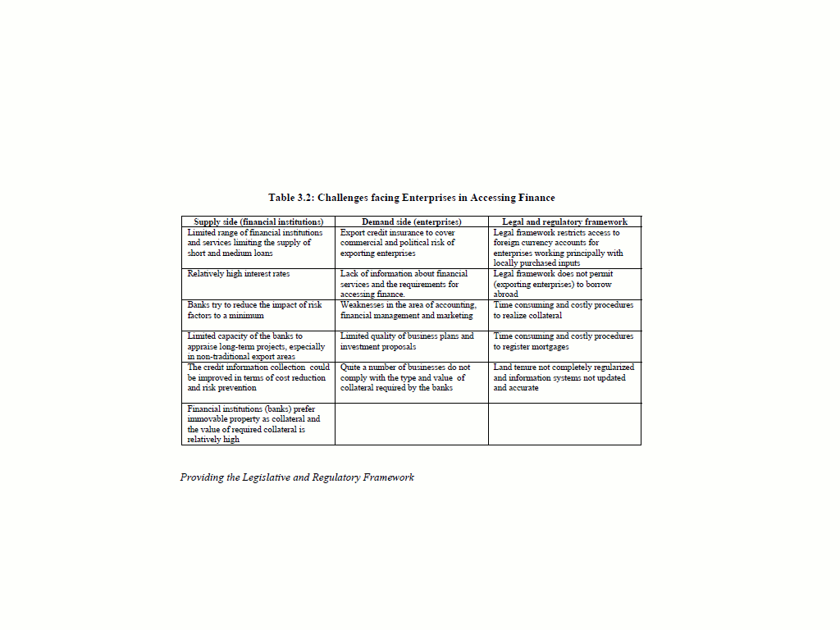

Slide 18
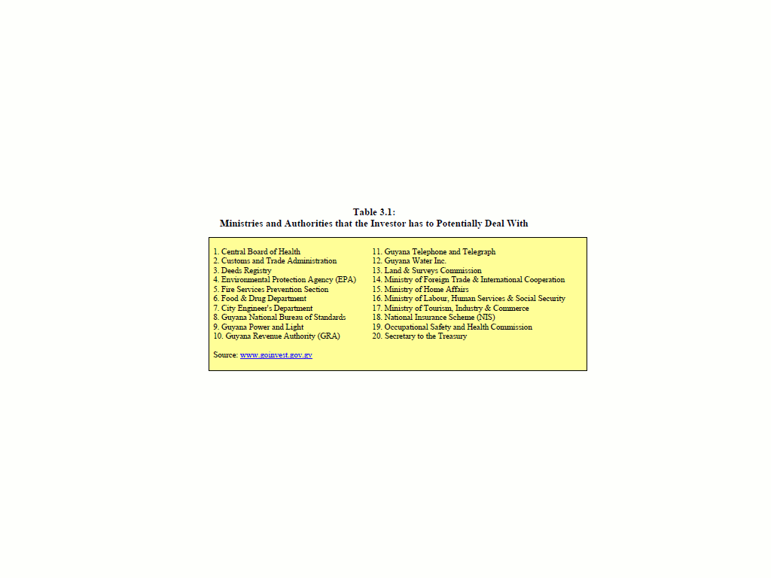

Slide 19
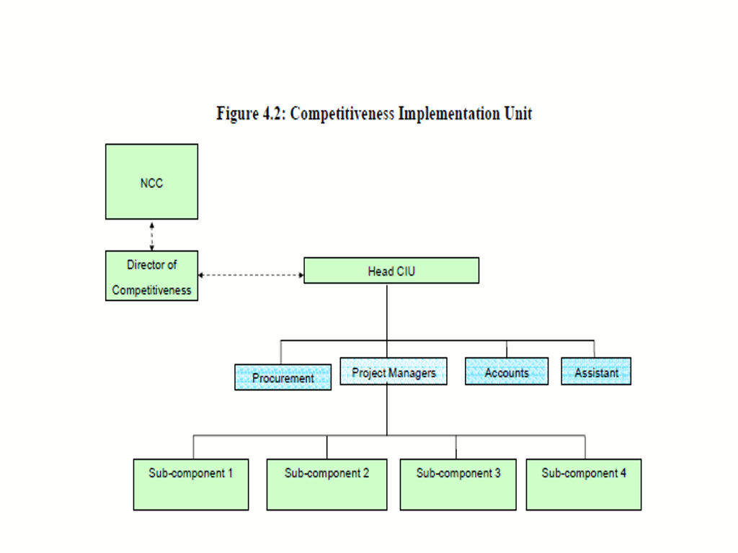

Slide 20
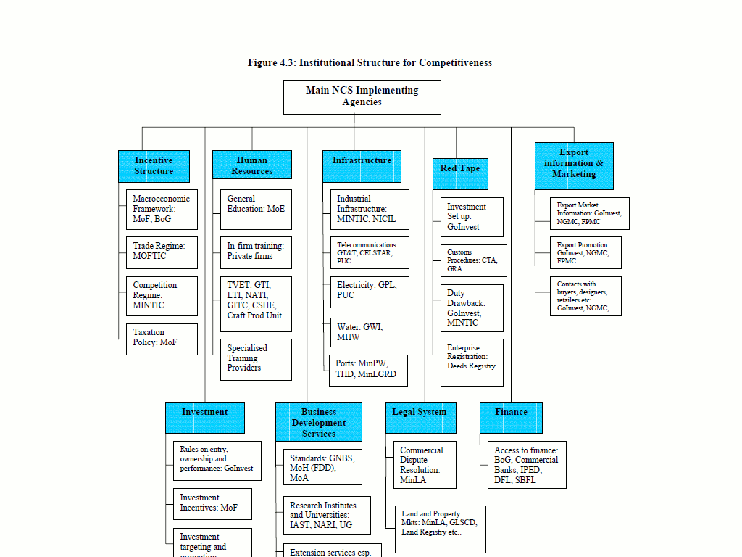

Slide 21
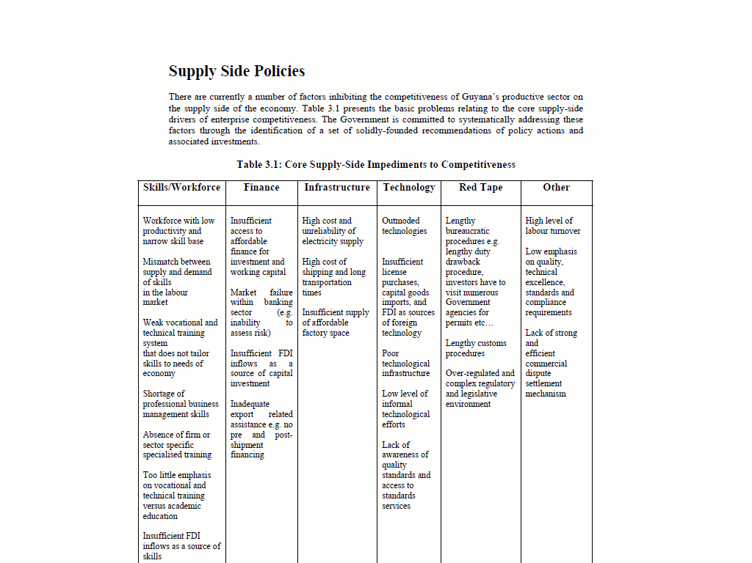

Slide 22
Thank you

Slide 23
Questions

