Slide 1




Presentation to Workshop on Establishment of a National Competitiveness & Productivity Council for Saint Lucia
17th September 2011
Adrian Devitt,
National Competitiveness Council

Slide 2
Agenda
The Irish National Competitiveness Council
Appendix
How does Ireland perform?
Priority areas for public policy

Slide 3
The National Competitiveness Council?

Slide 4

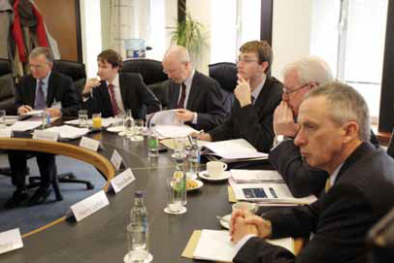
The National Competitiveness Council
Established by Government in 1997 as part of the Partnership 2000 Agreement
Reports to the Prime Minister (Taoiseach) on key competitiveness issues facing the Irish economy and polices to enhance competitiveness
Membership includes people with relevant expertise in competitiveness, employer and trade union representatives, CEO of Forfás, and a representative from the Department of Enterprise
NCC is also advised by senior officials
from key Government Departments
Supported by Forfás
Notes:
The Competition Authority and the National Competitiveness Council have separate – but very complementary - mandates. The job of the Competition Authority is set out in legislation. It has vital policy advisory, enforcement and executive functions. The NCC is an advisory body. We monitor national competitiveness and recommend to Government the policies which in our view will enhance the competitiveness of Irish firms and enterprises.

Slide 5
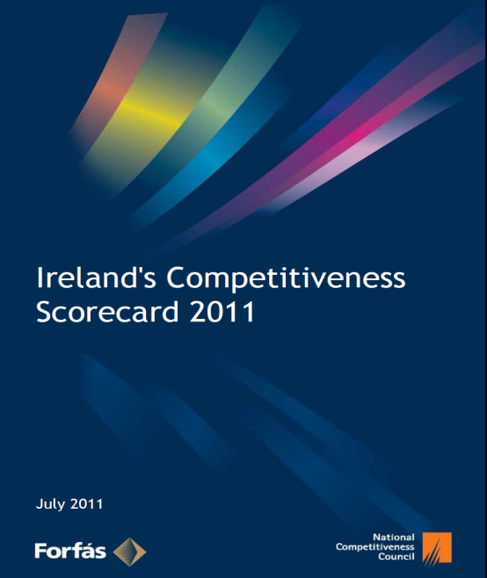
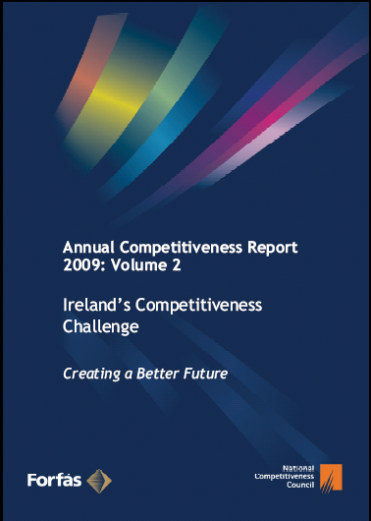
The work of the NCC
NCC Annual reports
Ireland’s Competitiveness Scorecard
Ireland’s Competitiveness Challenge
Notes:
To publish two core Annual Competitiveness Reports –
ICS assesses Ireland's international competitiveness performance across 127 statistical indicators in relation to 17 competitor countries
The Challenge sets out he main challenges facing the business sector in Ireland over the medium term and the policy responses required to address them.
Prepare such other reports on priority competitiveness issues, as appropriate, with recommendations on measures required to improve competitiveness.

Slide 6
What is competitiveness?
‘…all those factors which impact on the ability of firms in Ireland to compete on international markets in a way which provides our people with the opportunity to improve their quality of life’
Competitiveness affected by costs, prices and pay and also depends on better business performance through efficiency, effectiveness, innovation and productivity
Competitiveness is the essential foundation for national economic and social progress – vital to addressing the employment and unemployment challenges
Notes:
Competitiveness encompasses all those factors which impact on the ability of firms in Ireland to compete on international markets in a way which provides our people with the opportunity to improve their quality of life.

Slide 7
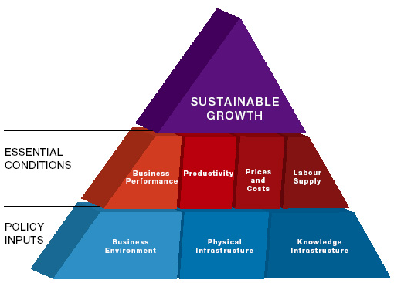
NCC competitiveness pyramid

Slide 8
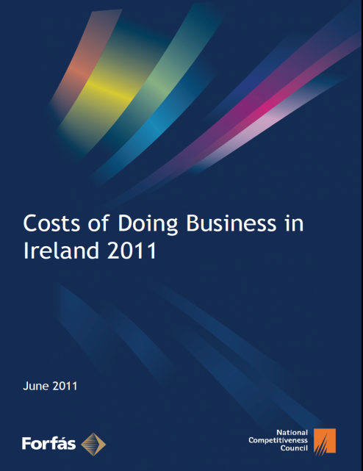


Other studies
Other NCC reports
Costs of Doing Business
Driving Export Growth
Statements on Energy / Education

Slide 9
2. How does Ireland perform?
Notes:
Competitiveness encompasses all those factors which impact on the ability of firms in Ireland to compete on international markets in a way which provides our people with the opportunity to improve their quality of life.

Slide 10
Net exports are the only positive contribution to growth
Contribution of Net Exports to GDP
Source: Forfás calculations, CSO National Accounts.

Slide 11
Ireland’s cost competitiveness deteriorated sharply between 2001 and 2008, with some improvement since then
Harmonised Competitiveness Indicators January 1995-July 2011 (January 2005 =100)
Source: Central Bank of Ireland, Forfás calculations

Slide 12
Ireland has slipped considerably in the global competitiveness rankings since 2000
Ireland’s ranking in Global Competitiveness Reports 1997-2011
Source: World Economic Forum Global Competitiveness Report; Institute of Management Development Global Competitiveness Yearbook

Slide 13
Strengths
Weaknesses
  Resilient export performance in face of collapse in global trade but sectoral performance has varied significantly
  Inward FDI remains relatively strong – role in stabilising the economy over the downturn
  Improved infrastructure, education and R&D performance (risk of faltering on R&D?)
  Pro-enterprise tax and regulatory environment – policy challenge to sustain this?
  Dependence on property and household borrowing has been exposed
  Burden of private and public debt
  Long-term unemployment
  Cost competitiveness poor – despite recent (cyclical?) improvements
  Slow productivity growth
  Credit availability and cost
  Falling world market share in manufacturing: services better
  Worrying fall in performance in scientific, mathematical and reading literacy
Notes:
Note on Trade
In terms of global share in trade- yes it is correct statement to say that Ireland’s market share of global manufacturing exports have fallen, while our share of global services trade has grown.
While Irish merchandise exports have grown since 2000, they have declined when expressed as a percentage of global merchandise trade. In 2000 Ireland held 1.20 percent of world merchandised trade, in 2009 this share had declined to 0.92 percent.
Irish services exports have grown considerably since 2000. Ireland’s share in global services exports has increased from 1.24 percent in 2000 to 2.89 percent in 2009.

Slide 14
4. Priority areas for public policy

Slide 15
1. Cost of Doing Business
Restoration of cost competitiveness is central to economic recovery and employment growth
Significant improvements in Ireland’s cost competitiveness over the last two years but further progress required
Cost of a range of business inputs remain relatively expensive - property costs, calls from landlines and legal fees etc.
Focus on competition in domestically traded services, including public services
  Introduce and ensure contestability where possible
  Pay particular attention to professional groups

Slide 16
2. Increased productivity – the only route to improving competitiveness and raising living standards
“Productivity isn't everything, but in the long run it is almost everything.” - Paul Krugman
Need to complement reduction in costs
Are we adequately focused on improving productivity?
Productivity levels are average (GNP)
Productivity growth rates are improving (but driven by compositional effects)
Do we adequately incorporate productivity, and its sister innovation, in budgetary and policy decisions?
Who is responsible for promoting policies that drive productivity?

Slide 17
3. Access to Credit
The annual rate of change in lending to the non-financial corporate sector has been negative since late 2009
Contraction in lending to this sector has continued in recent months
The difficulties in the banking sector are likely to lead to continued difficulties for the SME sector in accessing credit supply

Slide 18
4. Labour Market Activation
ESRI expect that employment will average 1.82 million in 2011 and that unemployment will average 14.5%
  Replacement rates should be revised to ensure no RR exceeds 100%. In the longer term, no RR should exceed 70%
  Reform social welfare so that benefits decline in line with the length of time a person is out of work
  Conditionality of social welfare needs to be strengthened
Activation - relevant job search, training, education and employment opportunities for different target groups.
Participation – ensuring that training and education needs of target groups are provided for through enterprise relevant programmes
Upskilling – implementation of National Skills Strategy
Address skills shortages
  Shortages of skills needed in the exporting sectors
  Implement actions recommended by EGFSN in sectors such as ICT, medical devices, food and drink, green enterprises and the biopharma-pharma-chemicals sector
Notes:
High quality social welfare systems (i.e. generous protection) should be accompanied by high levels of conditionality in order to ensure their sustainability. Conditionality of social welfare needs to be strengthened.

Slide 19
5. Taxation and Fiscal Policy
Ensure a sustainable tax system
Without measures to broaden tax base, taxes on income would inevitably have to rise further, which would damage competitiveness
  Valuation based tax on residential property
  User charges for treated water and third level education (without creating a barrier to entry for prospective students)
Promote fiscal stability
  NCC supports the establishment of an independent Fiscal Advisory Council
  Independence, accountability, full access to information, capacity to stress test taxation and spending scenarios
Notes:
Higher taxes on income can be a disincentive to people to remain in or return to the labour market whereas a valuation based residential tax system and user charges do not affect the incentive to work if structured correctly. A competitive tax wedge is also an important competitive advantage in attracting and retaining highly skilled and internationally mobile workers.

Slide 20
6. Education
Ensure the quality of education and training
  Concerns over Programme for International Student Assessment (PISA) results, and concerns from industry and third level
  Financial constraints cannot be an excuse for deferring structural reform
  Priority measures highlighted in the NCC’s 2009 Statement on Education and Training be progressed immediately.
  Importance of enhancing the quality of teaching - professional and in-service development should be frequent, continuing and progressive during a teacher’s career
  At third level, there is a need for adequate resourcing
  It is also essential that there is a continuous process of reform at all levels of education to improve performance

Slide 21
The Challenge for education – positioning for the three types of Jobs
Transformational – often involving physical activity; e.g. construction; food preparation; under capitalised farming
Transactional – e.g.routine white collar jobs, call centres
Interactional – relying on knowledge, expertise and collaboration with other people
First two suffer from intense competition internationally, low pay and margins – and often mobile and can be automated. Third tends to be high value added, knowledge intensive, human dependent and slow to move base

Slide 22
7. Infrastructure
Ireland’s distribution infrastructure is perceived poorly
  Air, water and energy infrastructure also perceived to be weak
World class telecommunications are vital to our ability to do business
  Ireland lags behind leading countries in terms of upgrading the local broadband access network to fibre and on offering very fast broadband speeds over fibre
Prioritise and deliver infrastructure projects offering greatest return
  Welcome commitment to publish cost benefit analyses for major infrastructure proposals
  Priorities include broadband, potential water shortages in Dublin and other key regional centres.
  Integrated approach to infrastructure planning and delivery

Slide 23
8. Property costs
1. Competitive property prices more important than a positive rate of return from NAMA?
2. Put measures in place to ensure we never again have a property bubble – other prosperous countries have avoided this trap.

Slide 24
9. Research and Innovation Policy
Ambitious goal of making Ireland the best place in Europe to turn research & knowledge into products & services
Substantial progress through:
  Ongoing implementation of the SSTI 2007- 2013
  Unprecedented investment in Ireland’s research base; and
  Commercialisation of ideas from research activity in Ireland
Overall level of innovative activity within Irish firms at almost 45%
  Ireland ranks 7th overall in terms of innovation activity (rates are highest for Germany (63%),Belgium (52%) and Finland (51%)
  Despite the relatively strong ranking, more than half of all firms in Ireland are not innovation active
Innovative enterprises are more likely to be engaged in exporting (66%) when compared to non-innovative enterprises (33%)
Ireland should focus on centres of excellence with critical mass so that basic and applied research can be supported.
Research prioritisation exercise is very welcome

Slide 25
Some wrap up thoughts
Discussion of FDI versus “indigenous industry” – a false choice? Both and...not either or!
Importance of “ Internal competition”; vital need for directing incentives away from non traded and towards traded sectors. Should be on agenda for all Government departments.
Efficient and innovative non- traded sectors will increase competitiveness of internationally traded sectors – and create new exporting businesses – e.g. education and health care

Slide 26
Striving to be world class
Being average only works when you want average living standards. How can we engender a culture that seeks to be world class at everything we do that is vital for competitiveness – education, transport, R&D, innovation, etc.
Who should we be seeking to learn from – who should we be seeking to beat! Who has been improving their competitiveness while we were building houses and driving up the cost of land?
  Finland in primary and secondary education?
  Israel in promoting high tech start-ups?
  Sweden in delivering of advanced broadband?
  Singapore in delivering efficient public services?
  Are there other newly emerging competitors?
Notes:
Primary and secondary education:
According to the WEF, Finland is ranked 1st in terms of the “Quality of Primary Education” (survey data); Ireland is ranked 11th.
Finland is also ranked 3rd in terms of the Quality of its Overall Education System – Ireland is ranked 11th.
In terms of quality of maths and science education, Finland is ranked 3rd and Ireland 34th.
Singapore also scores consistently highly across most education indicators.
High Tech Start Ups
Advanced Broadband
According to WEF, Sweden ranks 1st in terms of the ‘Availability of the Latest Technologies; Ireland ranks 32nd.
In terms of the number of internet users, Sweden is ranked 5th and Ireland is ranked 27^{th.}
For, broadband internet subscriptions Sweden is ranked 10th and Ireland is 27th.
Sweden is ranked 3rd for International Internet bandwidth (kb/s)/capita while Ireland is 21st.
Public Services
IMD ranks Singapore 1st for: Legal and Regulatory Framework (Ireland is 6th); Adaptability of Government Policy (Ireland is 23rd), Transparency (Ireland is 21st); and Bureaucracy (Ireland is 10th)
Efficiency of Implementation in respect of Government Decisions sees Singapore ranked 1st and Ireland 28^{th.}
Ireland is ranked 1st for Public Sector Contracts being sufficiently open to Foreign Bidders (Singapore is 5th).

Slide 27
Peter Drucker
“The greatest danger in times of turbulence is not the turbulence; it is to act with yesterday’s logic”

Slide 28
Thank You www.competitiveness.ie

